Slide 1
Playwright Tool
Vignesh Kumar Ayyappan

Slide 2
Agenda
Introduction
Installation
Writing Tests
Actions
Navigation
Interactions
Assertions
Generating Tests
Recording a test
Generating Locators
Running Tests
Run Tests and Show Browsers
View and Run All Tests
Run Tests on Specific Browsers
Debugging Tests
Debug tests in UI mode
Debug tests with Playwright Inspector
Test Reports
Trace viewer

Slide 3
Introduction
Playwright Test was created specifically to accommodate the needs of end-to-end testing.
Playwright supports all modern rendering engines including Chromium, WebKit, and Firefox.
It supports operating system likes Windows, Linux, and macOS, locally or on CI.
Headless or Headed with native mobile emulation of Google Chrome for Android and Mobile Safari.

Slide 4
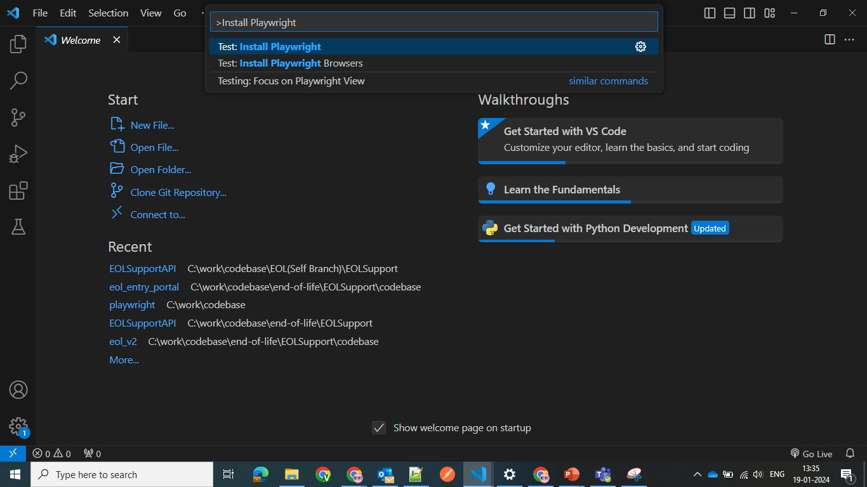
Installation
Install the VS Code extension from the marketplace or from the extensions tab in VS Code.

Slide 5
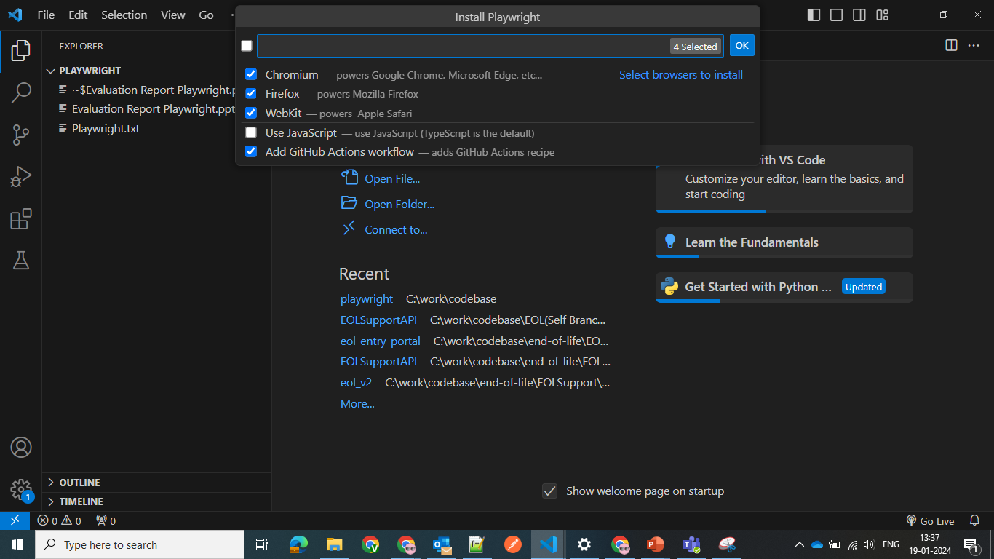
Installation
Choose the browsers you would like to run your tests on.
These also can be configured later after Playwright.config file generated.

Slide 6
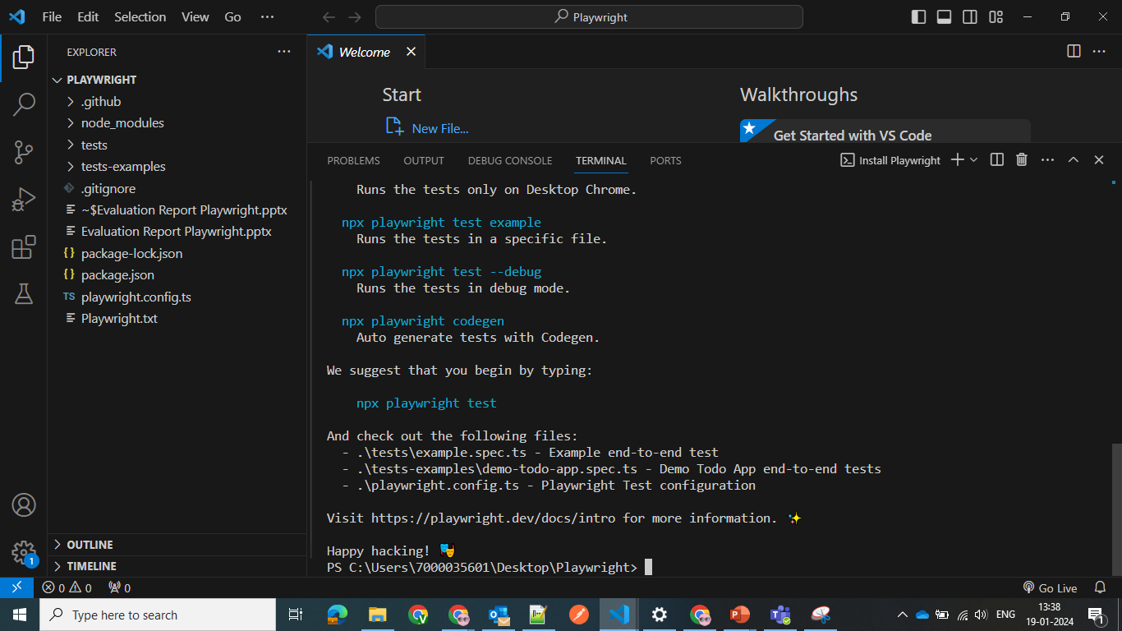
Installation
It will generate files required for testing with config files.

Slide 7
Installation
We can also install it using following commands.
Use VS-code terminal to run following commands:
Run "npm init playwright@latest“
Above command will install required files for testing.

Slide 8
Writing Tests
Playwright tests are simple, they
perform actions, and
assert the state against expectations.
Example Test
test('get started link', async ({ page }) => { await page.goto('https://playwright.dev/'); // Click the get started link. await page.getByRole('link', { name: 'Get started' }).click(); // Expects page to have a heading with the name of Installation. await expect(page.getByRole('heading', { name: 'Installation' })).toBeVisible(); });

Slide 9
Writing Tests - Actions
Navigation:
Most of the tests will start with navigating page to the URL.
After that, test will be able to interact with the page elements.
eg: “await page.goto('https://playwright.dev/’);”
Interactions:
Performing actions starts with locating the elements. Playwright uses Locators API for that. Locators represent a way to find element(s) on the page at any moment, learn more about the different types of locators available. Playwright will wait for the element to be actionable prior to performing the action, so there is no need to wait for it to become available.
eg: “await page.getByRole('link', { name: 'Get started' }).click();”

Slide 10
Writing Tests - Assertions
Playwright includes test assertions in the form of expect function.
To make an assertion, call expect(value) and choose a matcher that reflects the expectation.
eg:expect(success).toBeTruthy();
Playwright also includes async matchers that will wait until the expected condition is met.
For example, this code will wait until the page gets the title containing "Playwright“.
eg:await expect(page).toHaveTitle(/Playwright/);

Slide 11
Generating Tests
Playwright comes with the ability to generate tests using Codegen out of the box and is a great way to quickly get started with testing.
It will open two windows, a browser window where you interact with the website you wish to test and the Playwright Inspector window where you can record your tests, copy the tests, clear your tests as well as change the language of your tests.
Running Codegen:
Use the codegen command to run the test generator followed by the URL of the website you want to generate tests for.
The URL is optional and you can always run the command without it and then add the URL directly into the browser window instead.
Open VS code Terminal and run this command “npx playwright codegen”

Slide 12
Generating Tests – Recording a test
Run codegen and perform actions in the browser. Playwright will generate the code for the user interactions.
Codegen will look at the rendered page and figure out the recommended locator, prioritizing role, text and test id locators.
If the generator identifies multiple elements matching the locator, it will improve the locator to make it resilient and uniquely identify the target element, therefore eliminating and reducing test(s) failing and flaking due to locators.
With the test generator you can record:
Actions like click or fill by simply interacting with the page
Assertions by clicking on one of the icons in the toolbar and then clicking on an element on the page to assert against. You can choose:
‘assert visibility’ to assert that an element is visible
‘assert text’ to assert that an element contains specific text
‘assert value’ to assert that an element has a specific value

Slide 13
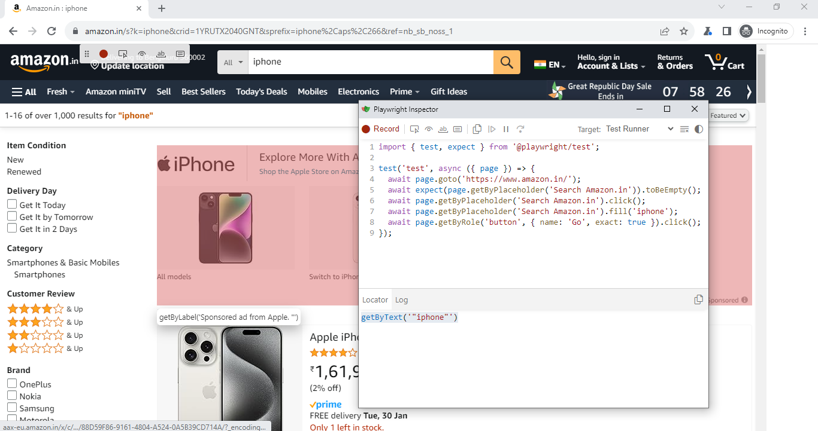
Generating Tests – Recording a test

Slide 14
Generating Tests – Recording a test
When you have finished interacting with the page, press the “record” button to stop the recording and use the”copy” button to copy the generated code to your editor.
Use the “clear” button to clear the code to start recording again. Once finished close the Playwright inspector window or stop the terminal command.

Slide 15
Generating Tests – Generating locators
You can generate locators with the test generator.
Press the “Record” button to stop the recording and the “Pick Locator” button will appear.
Click the “Pick Locator” button and then hover over elements in the browser window to see the locator highlighted underneath each element.
To choose a locator click on the element you would like to locate and the code for that locator will appear in the locator playground next to the Pick Locator button.
You can then edit the locator in the locator playground to fine tune it and see the matching element highlighted in the browser window.
Use the copy button to copy the locator and paste it into your code.

Slide 16
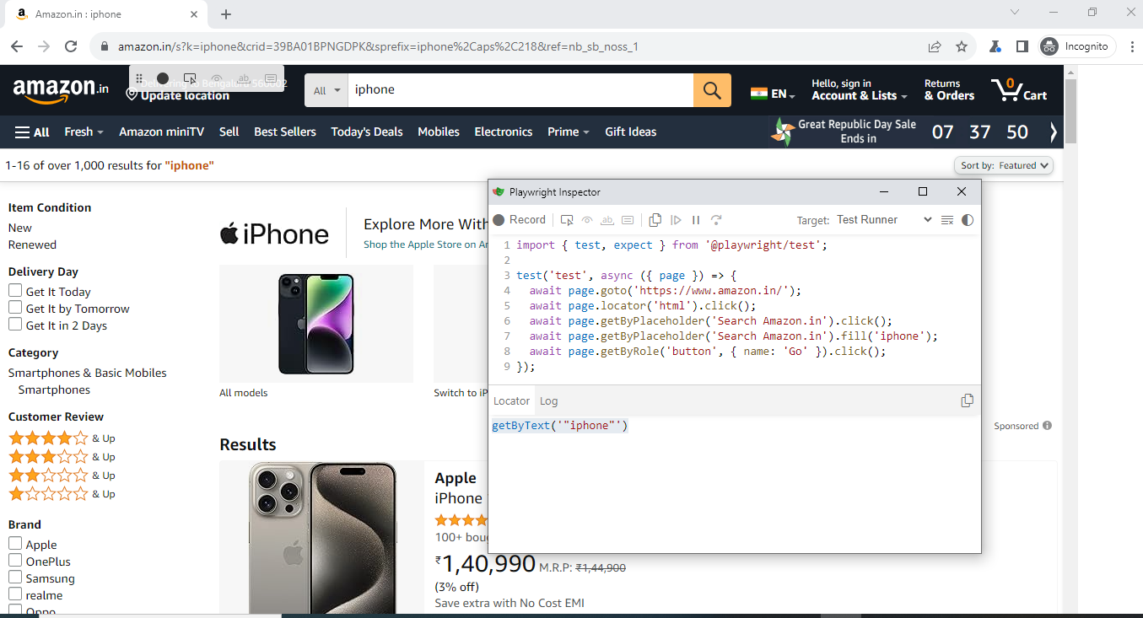
Generating Tests – Generating locators

Slide 17
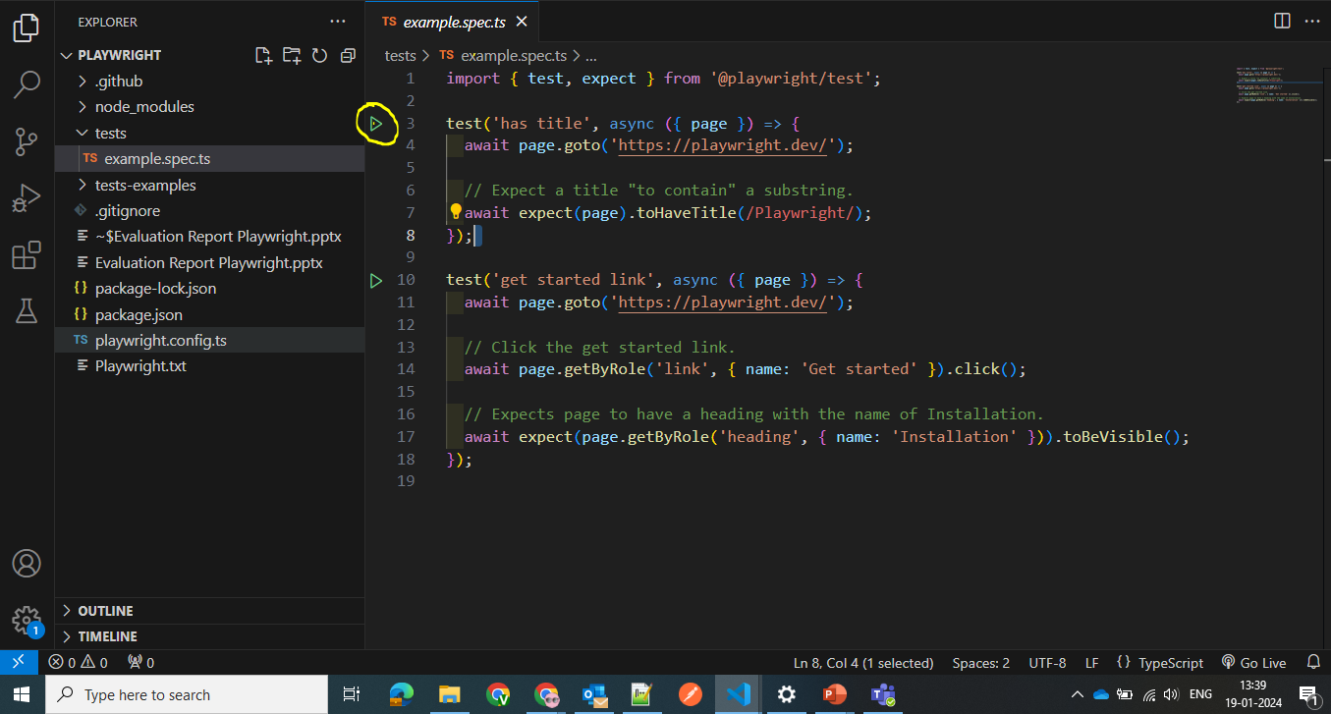
Running Tests
You can run a single test by clicking the green triangle next to your test block to run your test.

Slide 18
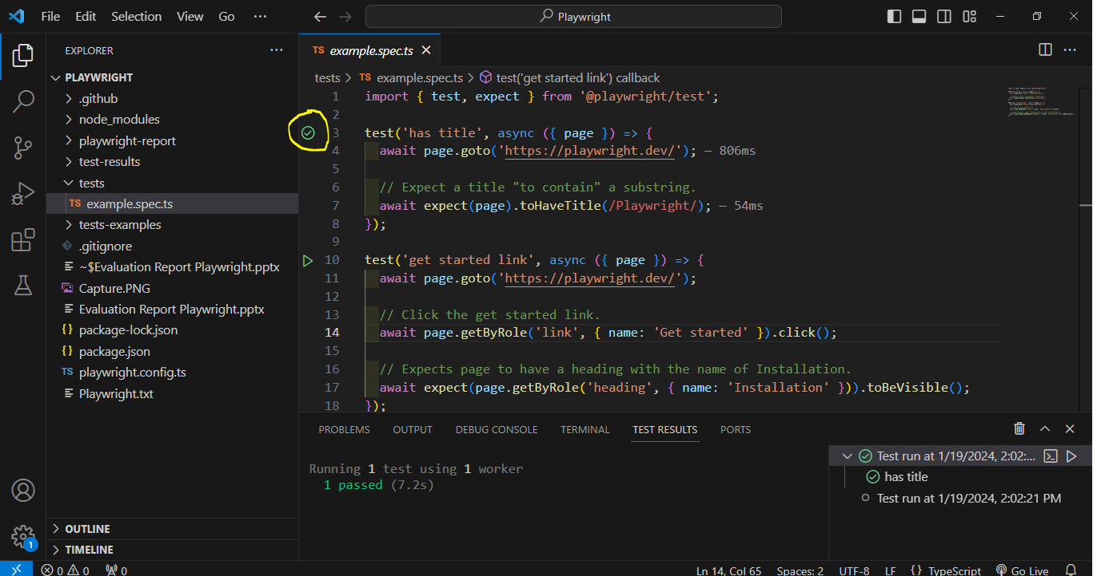
Running Tests
Playwright will run through each line of the test and when it finishes you will see a green tick next to your test block as well as the time it took to run the test.

Slide 19
Running Tests – Run Tests and Show Browsers
You can also run your tests and show the browsers by selecting the option Show Browsers in the testing sidebar.
Then when you click the green triangle to run your test the browser will open and you will visually see it run through your test.
Leave this selected if you want browsers open for all your tests or uncheck it if you prefer your tests to run in headless mode with no browser open.
Difference b/w Headless and Headed Mode:
Headed mode: Tests will give you the ability to visually see how Playwright interacts with the website.
Headless mode: Tests are run in parallel by default and are run in a headless manner, meaning no browser window will be opened while running the tests and results will be seen in the terminal.

Slide 20
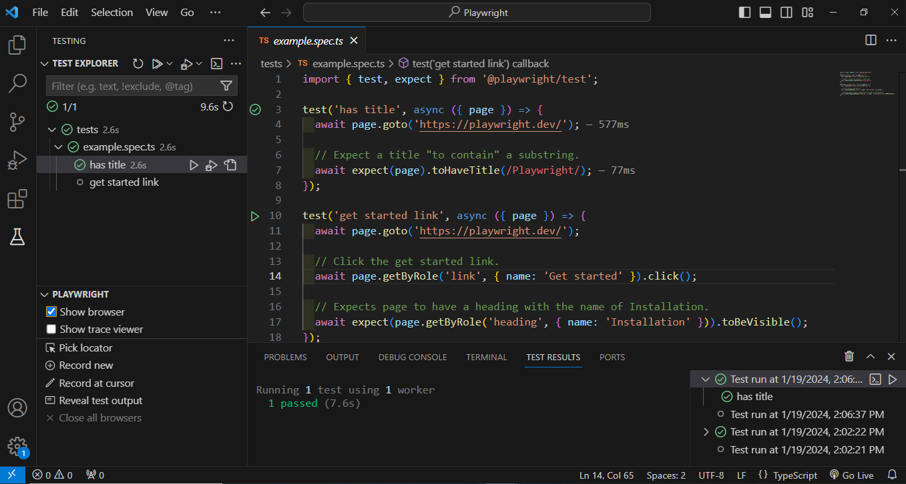
Running Tests – Run Tests and Show Browsers

Slide 21
Running Tests
Command line:
You can run your tests with the “playwright test” command. This will run your tests on all browsers as configured in the “playwright.config” file.
Tests run in headless mode by default meaning no browser window will be opened while running the tests and results will be seen in the terminal.
Run Command: npx playwright test
Run tests in UI mode:
We highly recommend running your tests with UI Mode for a better developer experience where you can easily walk through each step of the test and visually see what was happening before, during and after each step.
UI mode also comes with many other features such as the locator picker, watch mode and more.
Run Command: npx playwright test --ui

Slide 22
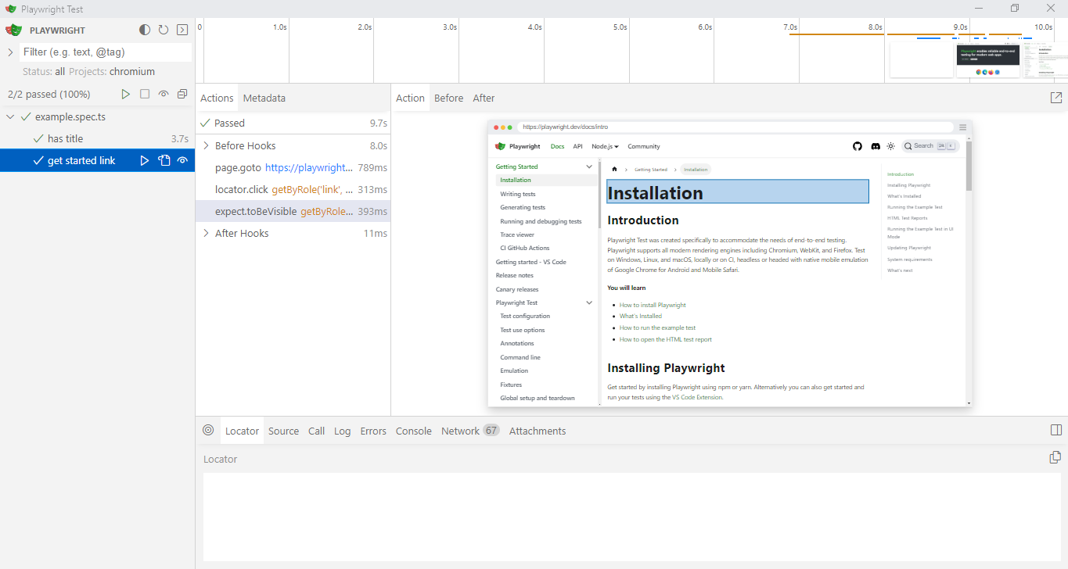
Running Tests – UI Mode

Slide 23
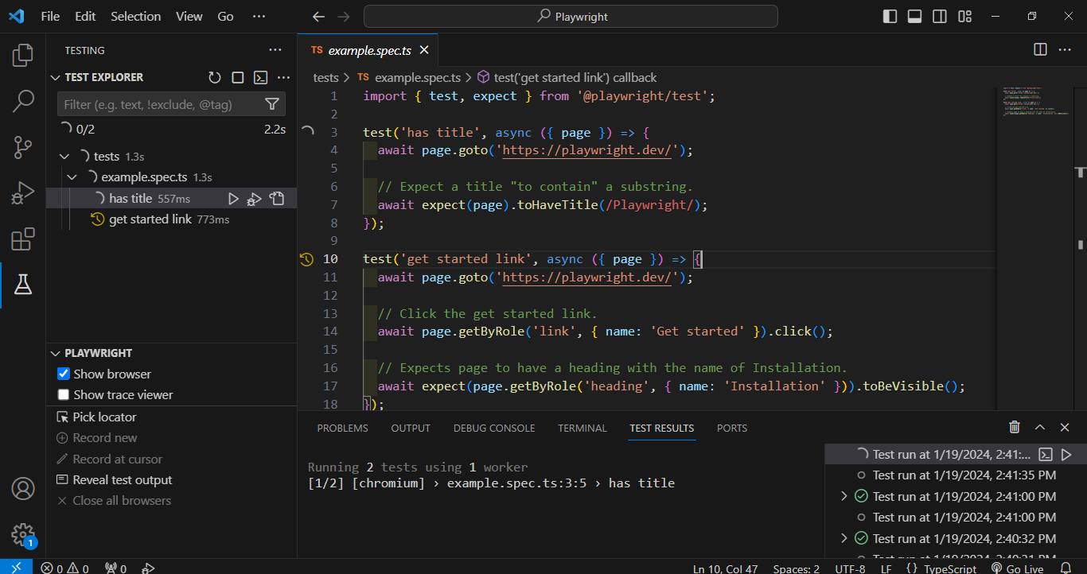
Running Tests – View and All tests
View all tests in the testing sidebar and extend the tests by clicking on each test.
Run all tests by clicking on the white triangle as you hover over the tests in the testing sidebar.

Slide 24
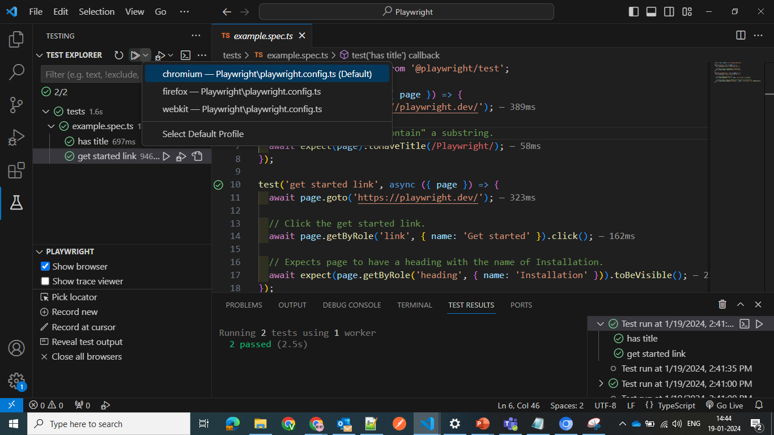
Running Tests – Run Tests on Specific Browsers

Slide 25
Running Tests – Run Tests on Specific Browsers
The VS Code test runner runs your tests on the default browser of Chrome.
To run on other/multiple browsers click the play button's dropdown and choose another profile or modify the default profile by clicking Select Default Profile and select the browsers you wish to run your tests on.
Run all tests by clicking on the white triangle as you hover over the tests in the testing sidebar.
Most using Terminal Commands:
Installing Playwright : npm init playwright@latest
Run Test : npx playwright test
HTML Test Reports : npx playwright show-report
Run tests in UI mode : npx playwright test --ui
Run tests in headed mode : npx playwright test –headed
Run tests on different browsers : npx playwright test --project webkit --project firefox
Run specific tests : npx playwright test landing-page.spec.ts

Slide 26
Debugging Tests
Since Playwright runs in Node.js, you can debug it with your debugger of choice e.g. using console.log or inside your IDE or directly in VS Code with the VS Code Extension.
Playwright comes with UI Mode, where you can easily walk through each step of the test, see logs, errors, network requests, inspect the DOM snapshot and more.
You can also use the Playwright Inspector, which allows you to step through Playwright API calls, see their debug logs and explore locators.
Debug tests in UI mode:
We highly recommend debugging your tests with UI Mode for a better developer experience where you can easily walk through each step of the test and visually see what was happening before, during and after each step.
UI mode also comes with many other features such as the locator picker, watch mode and more.
Run command: npx playwright test --ui

Slide 27
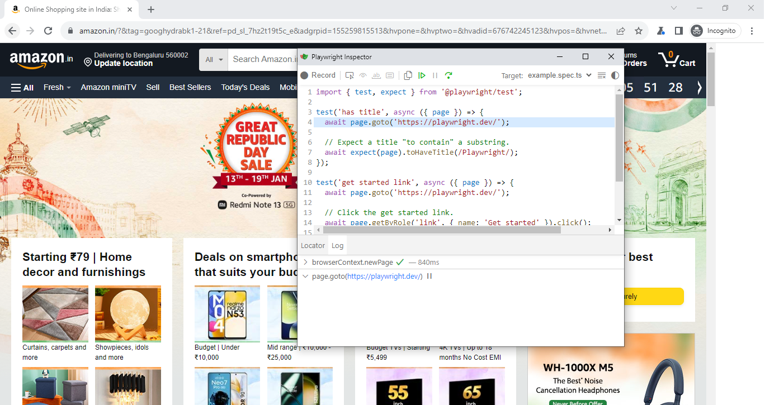
Debugging Tests - Debug tests with the Playwright Inspector
To debug all tests, run the Playwright test command followed by the “--debug” flag.
Run Command: npx playwright test --debug

Slide 28
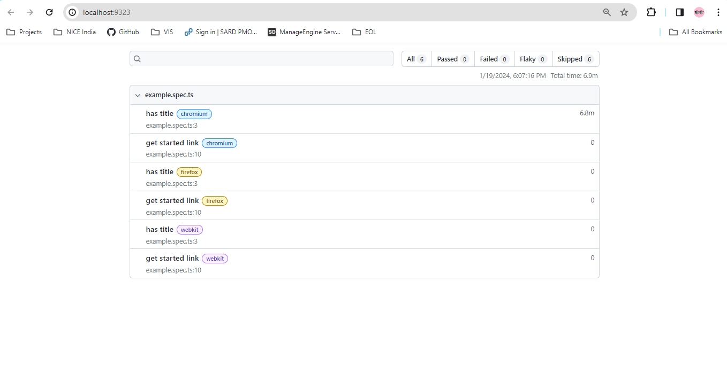
Debugging Tests – Test reports
The HTML Reporter shows you a full report of your tests allowing you to filter the report by browsers, passed tests, failed tests, skipped tests and flaky tests.
By default, the HTML report is opened automatically if some of the tests failed.
Run Command: npx playwright show-report

Slide 29
Debugging Tests – Trace viewer
Playwright Trace Viewer is a GUI tool that lets you explore recorded Playwright traces of your tests meaning you can go back and forward through each action of your test and visually see what was happening during each action.
By default, the HTML report is opened automatically if some of the tests failed.
In the HTML report click on the trace icon next to the test name file name to directly open the trace for the required test.
Run Command: npx playwright test --trace on
Viewing the trace:
View traces of your test by clicking through each action or hovering using the timeline and see the state of the page before and after the action.
Inspect the log, source and network, errors and console during each step of the test.
The trace viewer creates a DOM snapshot so you can fully interact with it and open the browser DevTools to inspect the HTML, CSS, etc.
To learn more about traces check out our detailed guide on Trace Viewer.

Slide 30
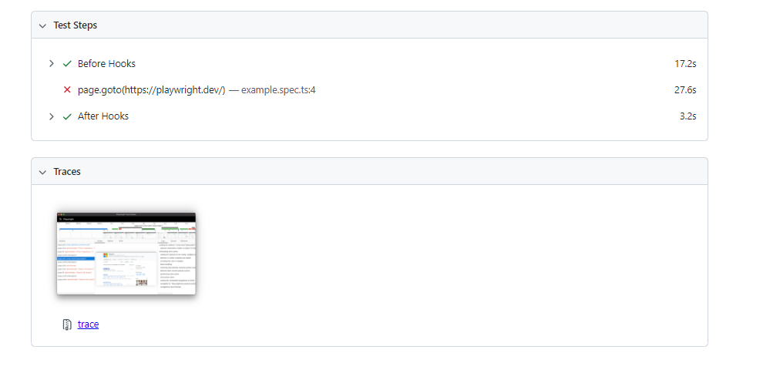
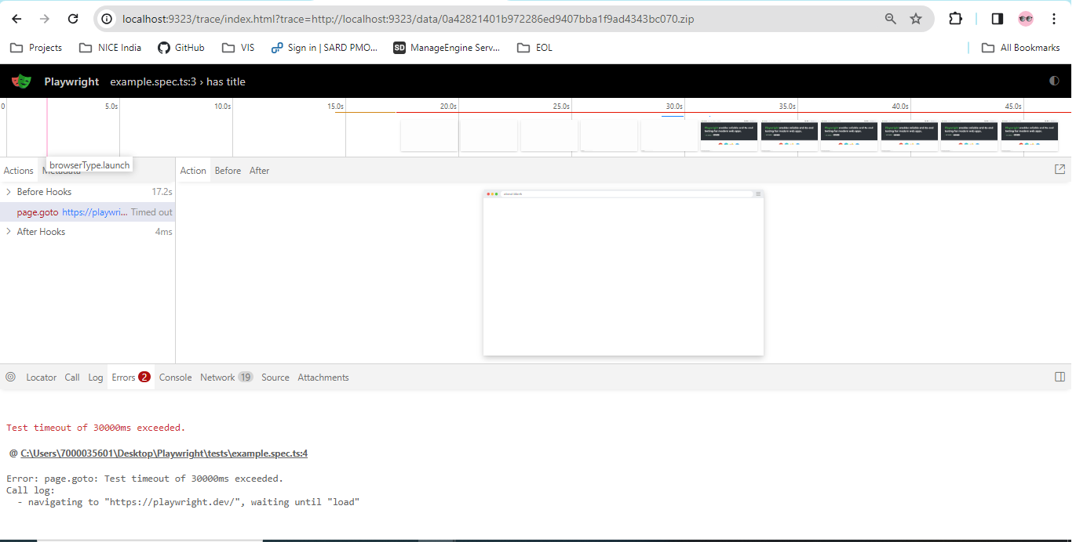
Debugging Tests – Trace viewer

Slide 31
Thank you

